Slide 1
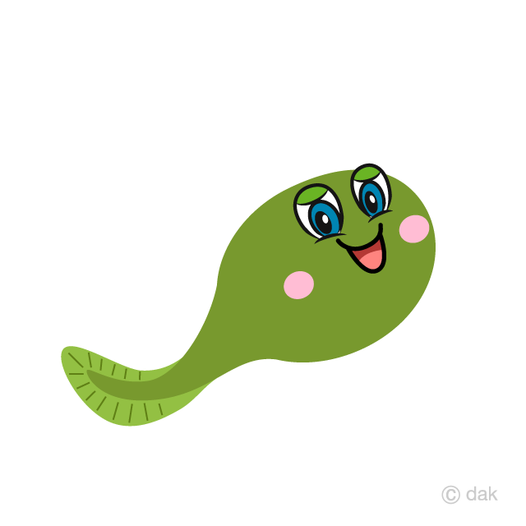
I’m A Little Tadpole
Sophie Webster

Slide 2
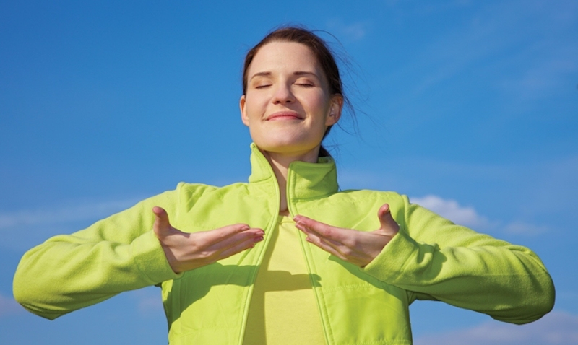
Breathing x3
Breathe in through the nose…hold for 3 seconds…and breathe out slowly and quietly through the mouth.

Slide 3
Ask permission to touch your partner

Slide 4

The Circle
I’m a little tadpole.

Slide 5

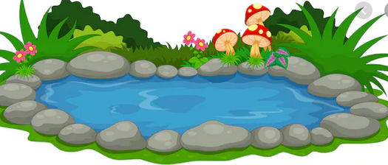
The Wave
Swimming in the pond.

Slide 6


The Calm
Waiting to become a frog.

Slide 7


The Walk
First I’ll grow my back legs.

Slide 8

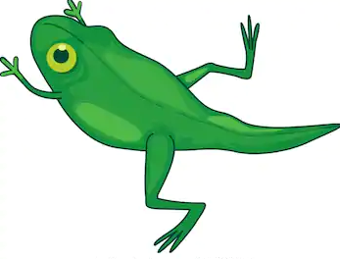
The Fan
Then I’ll grow my front.

Slide 9


The Drum
Lastly, my tail will fall off.

Slide 10

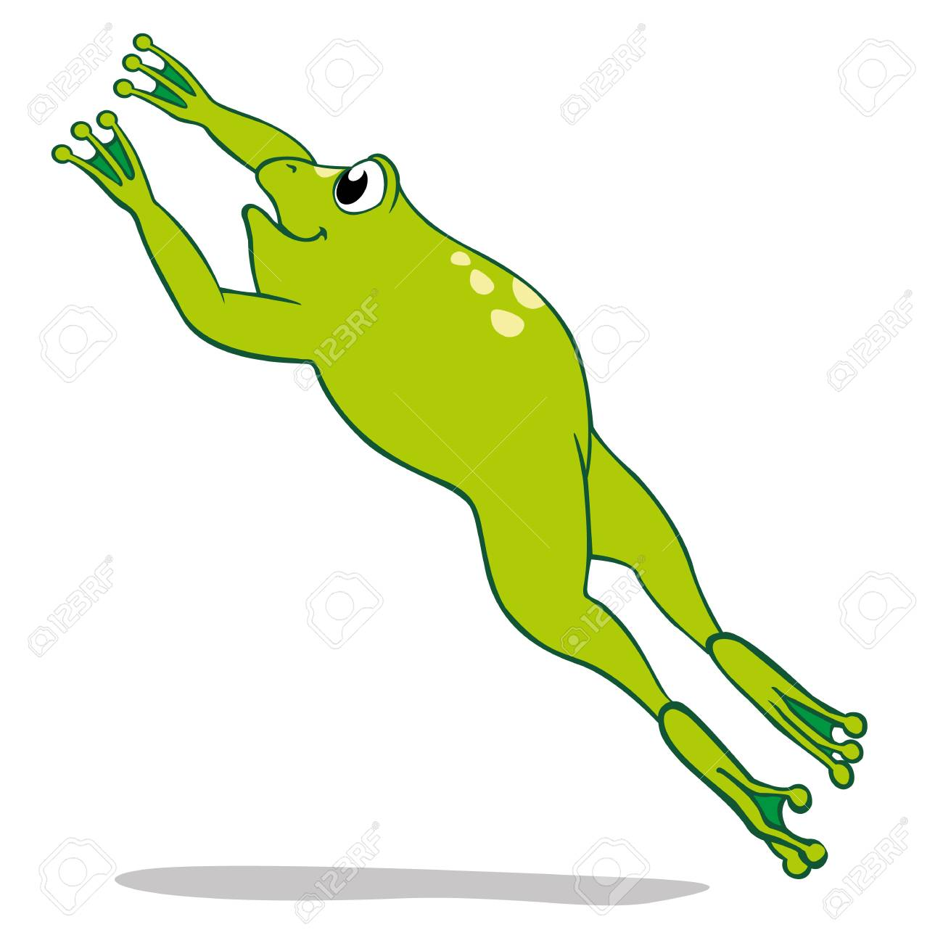
The Bounce
And then I am ready to jump!

Slide 11
Say thank you to each other!

