Slide 1
Notes:
Straight into a video today to give you a real feel of why we do what we do!

Slide 2
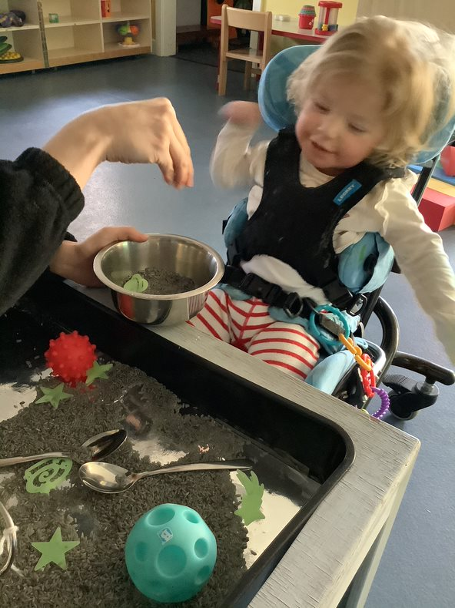
Sensory Trays Benefits - Fine motor skills - Language skills - Social skills - Maths and science skills - Meeting the sensory needs of our children (touch, taste, smell, sound)

Slide 3
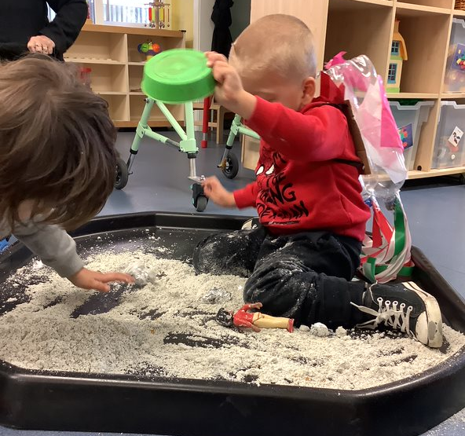
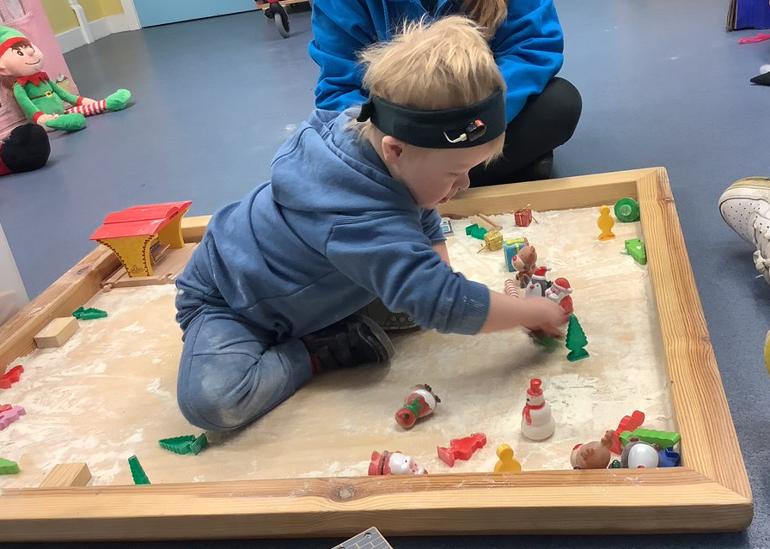
Dry trays (Easy) Dry sand, uncooked rice/pasta, flour, lentils/pulses, cereals, leaves/twigs, feathers
Dry textures fall away and the child can control contact with the texture.

Slide 4
Soft and dry trays Damp sand, glitter, cocoa powder, icing sugar, silly string, chalk
Textures that mostly fall away but some particles or bits may stick to hands

Slide 5
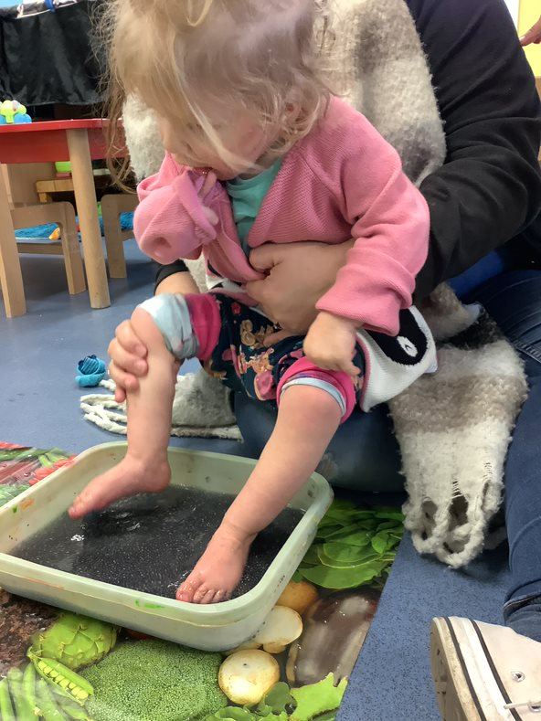
Wet trays Water, foam, baked beans, cooked pasta/lentils/rice, jelly, wet sand
Wet textures that stick to hands but can be easily removes by wiping.

Slide 6
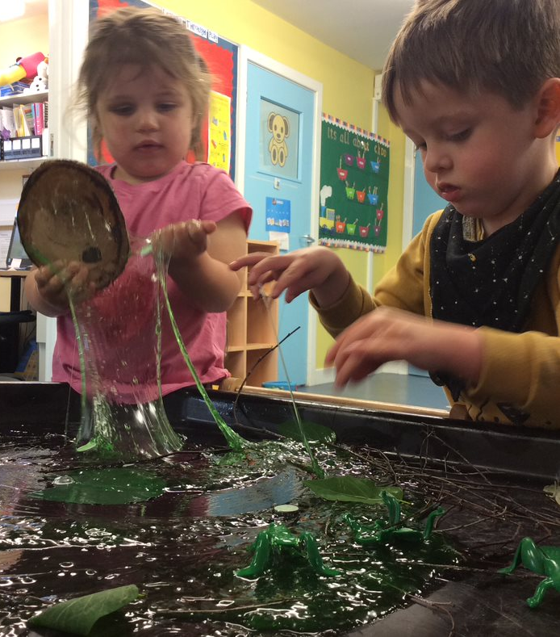
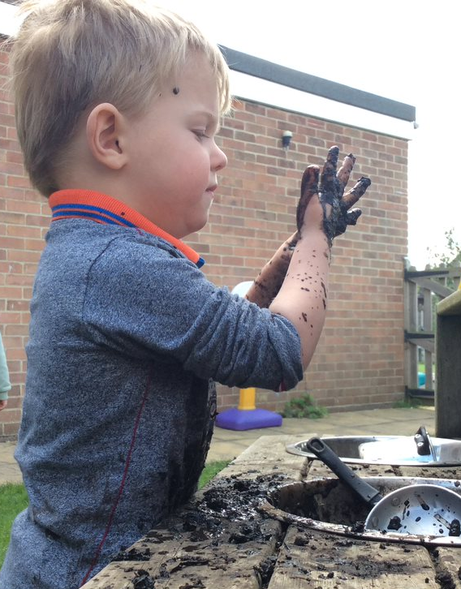
Messy trays (Challenging) Mud, porridge, custard, angel delight, melted chocolate, ice cream, glue, paint
Wet textures that stick to hands. Child has least control with these textures and they would require repeated wiping to remove.
Notes:
Shows the importance of ongoing remote support for families who are unable to attend educational settings.
Those are the figures, now hear from a parent who is still going through lockdown.

Slide 7
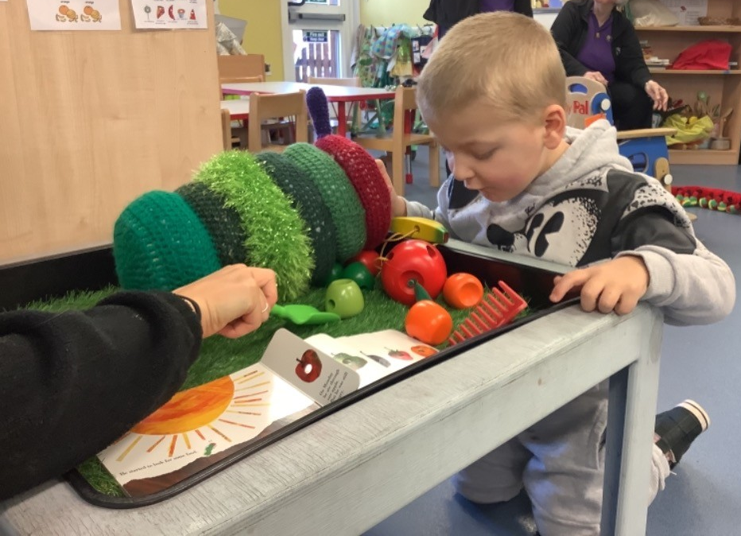
Sensory story trays
Use book alongside props, textures, smells and recorded sounds to encourage story telling.

Slide 8
Contact details
Call us on 01635 552458
Email us at admin.westberks@dingley.org.uk
Visit our website www.dingley.org.uk

Slide 9
Thank you for listening

