Slide 1
West Berkshire 2036 Vision and West Berkshire Council Local Plan to 2036
Bryan Lyttle- Planning and Transport Policy Manager
Gabrielle Mancini- Economic Development Officer

Slide 2
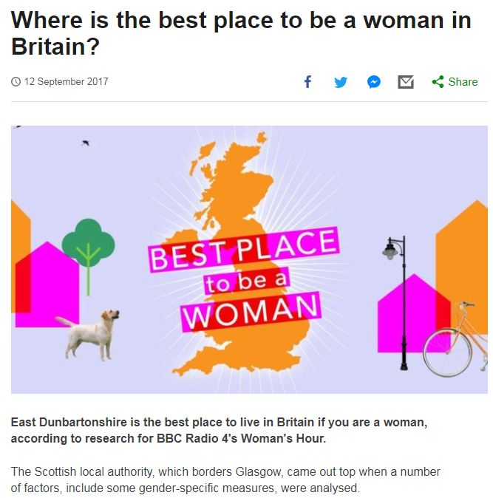
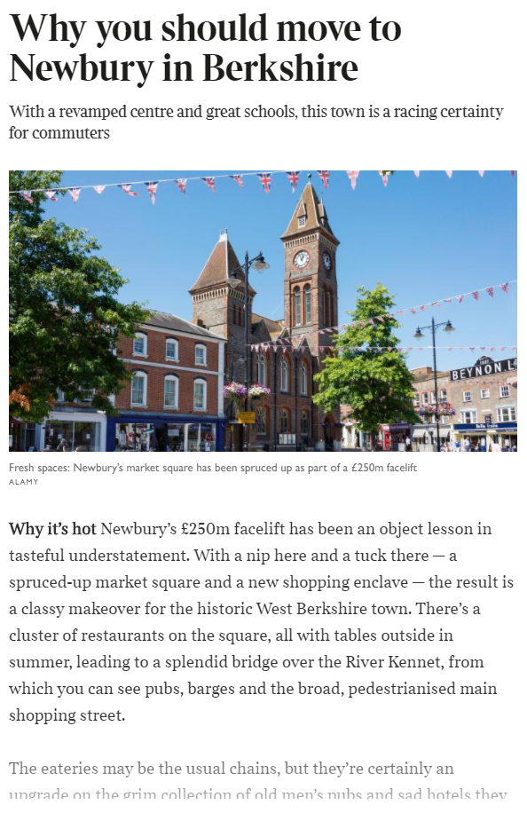
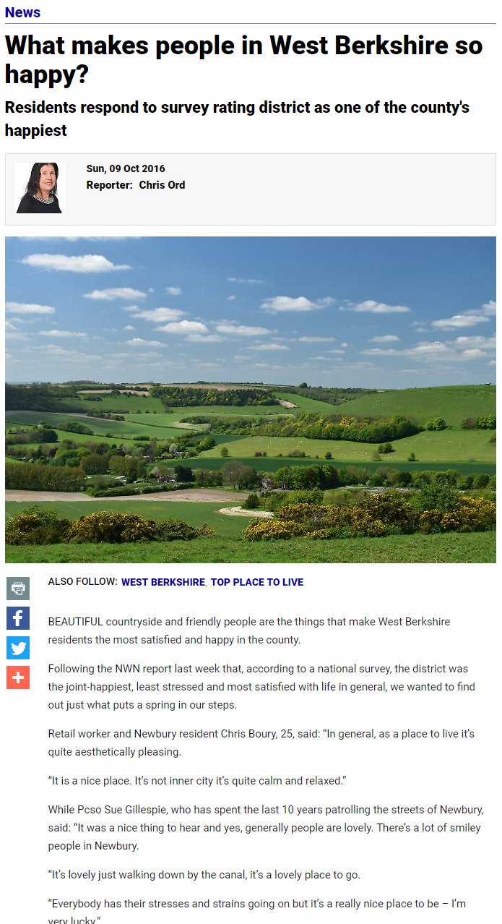
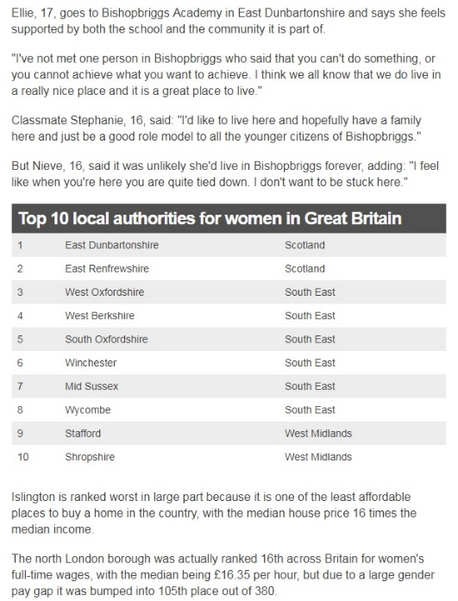
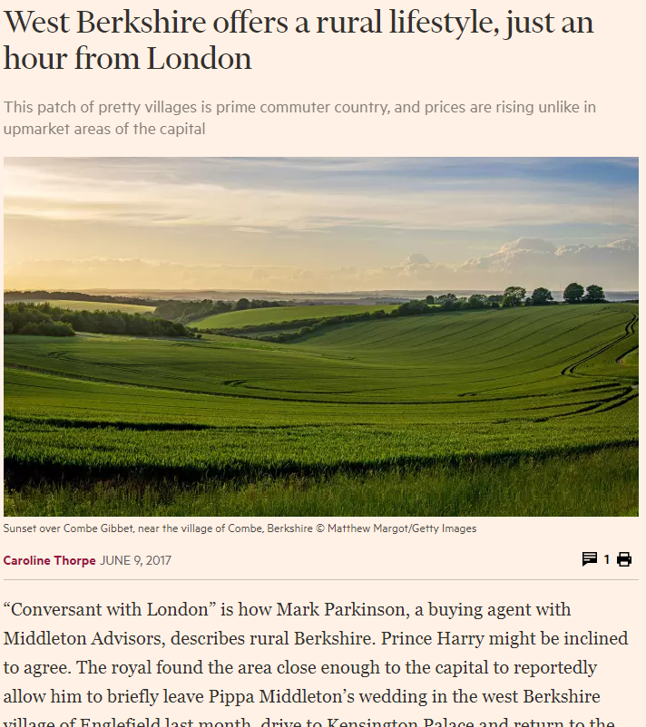
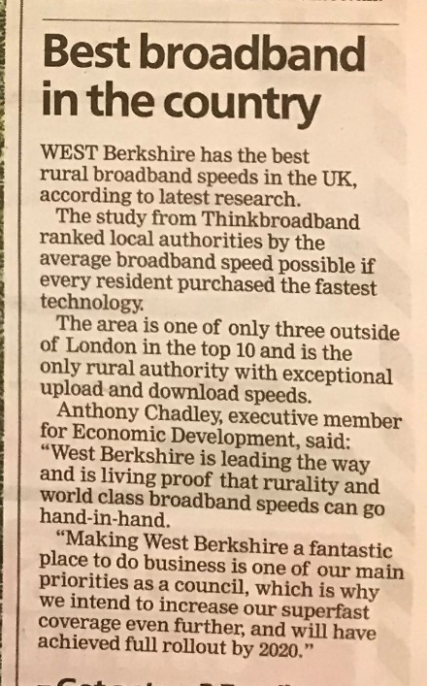
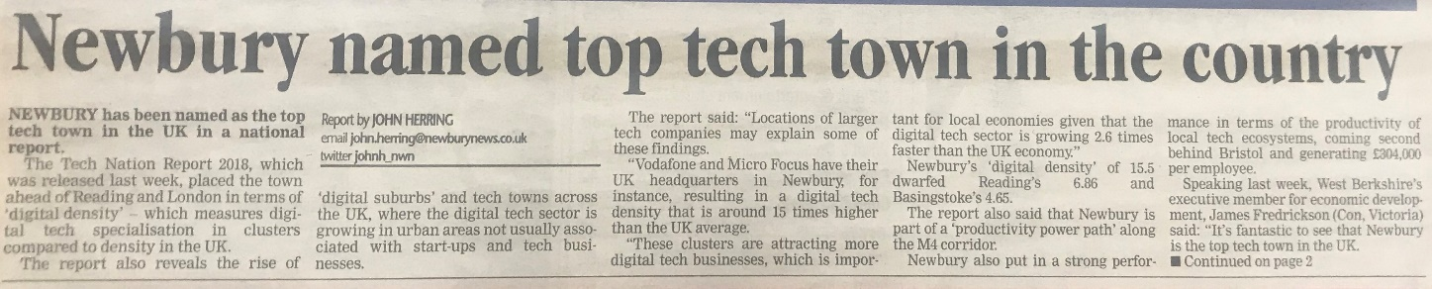
What they say about West Berkshire…

Slide 3
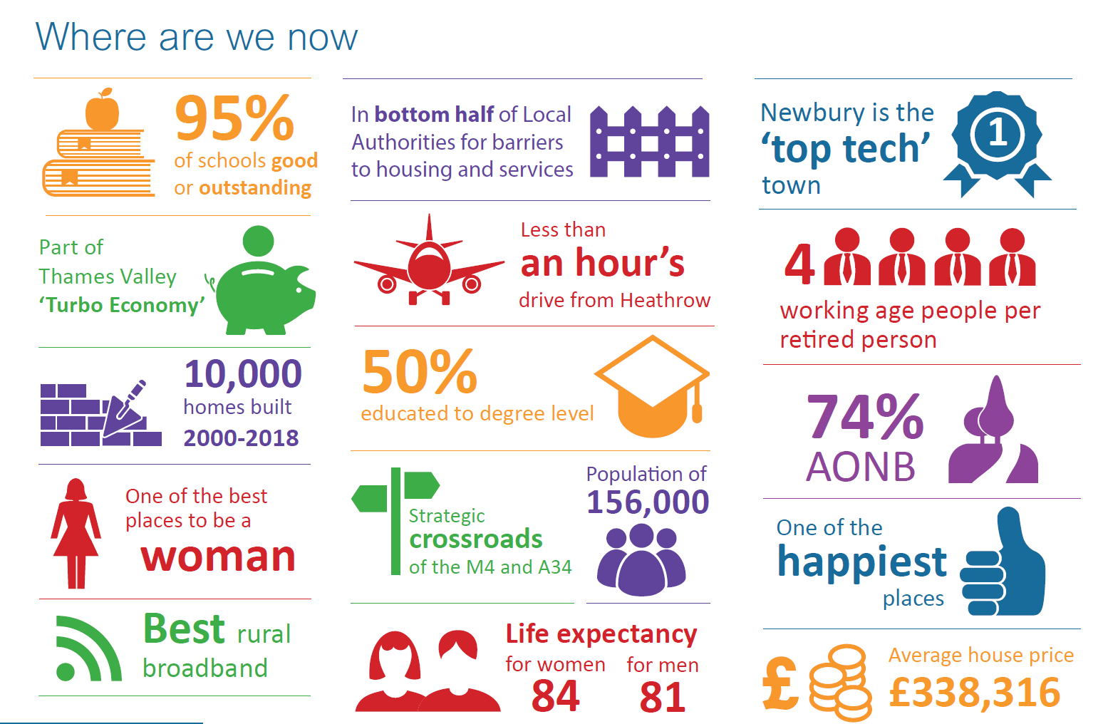

Slide 4
Five key areas
A West Berkshire:
where everybody has what they need to fulfil their potential
with a housing mix with something for everyone
that welcomes business, enterprise and industry into a productive, growing and dynamic local economy
where the health and wellbeing of residents of all ages is prioritised
with both beautiful, natural landscape and a strong cultural offering

Slide 5
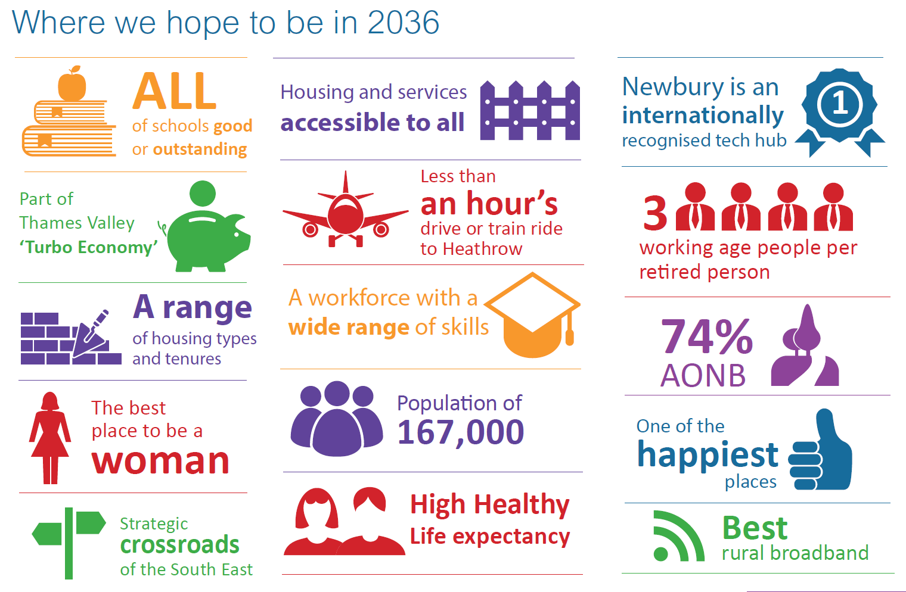

Slide 6
Timetable
Consultation closes on 31st October
Amendments considered and fed into final draft throughout November and December
Formal adoption by the Health and Wellbeing Board in January 2019 (provisional)
Considered at full Council in March 2019
Progress monitored by the Health and Wellbeing Board using outcomes framework
Refreshed at intervals agreed by the Health and Wellbeing Board

Slide 7
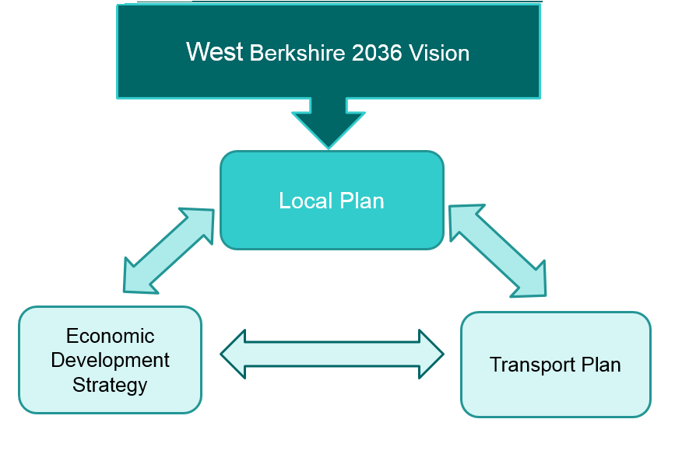
‘AOTS’

Slide 8
Timetable
 | Consultation | Examination | Adoption
Local Plan | 2019 | 2020 | 2020
EDS | 2019
Transport Plan | 2019
Leisure Strategy | 2019
Neighbourhood Plans | Ongoing

Slide 9






Newbury Town Centre Workplace Journey Share - LAUNCH
It’s FREE!
www.faxi.co.uk Download the free FAXI app today!
Notes:
There has been enthusiasm for a car share scheme to help those who work in Newbury town centre. The Corn Exchange approached the Council some time ago as they were keen to have something and at the Vision conference last year we said that we would be looking in to setting something up.
And, here it is…..Working with Faxi we have set up a Journey Share Group which is for anyone who works in Newbury Town Centre. It will mainly help link people up who travel by car but it can also be used to link other modes so if you wanted to start cycling but would prefer to cycle with others, these links can be made in this group too (or shared journeys on foot or by public transport). (Can maybe point out how you can view on a map who is registered and what journeys they are looking to share – image used on the slide).
It is a ‘closed’ group so each member’s registration will have to be authorised just so that we can check that the people signing up are from workplaces in the town. But this gives people comfort that everyone using it is doing so for the same purpose and they are likely to get a suitable match for their journey.
So, we are officially launching it today and we have Anthony here from Faxi who, if you haven’t spoken to already, will be around to chat to and help you register or download the Faxi app and tell you a bit more about it.
It is free for all those who work in Newbury and we hope it will be helpful in saving people money and reducing the number of work car journeys coming into the town.

